Slide 1

End to end Node.js app development in the cloud Azure use cases
Jose Miguel Parrella
May 21 2016
Node.js Live Beijing

Slide 2



关于我
开源软件人 = 15 年
Policy making, advocacy, community building, program management, CTO, entrepreneurship
Debian程序猿= 2007-今天
Brought nginx to Debian and Ubuntu
Canaima Linux 创造者
Venezuela’s national operating system, 4.6M users
Microsoft = 2010-今天
Open Source Strategy, now focused on Open Source in the Cloud
APT-based distros, Linux clusters, Perl, Node.js & Docker
github.com/bureado

Slide 3
Agenda
Node.js in Azure: 分享我们学到了什么
Cloud: 程序猿想要的东西

Slide 4
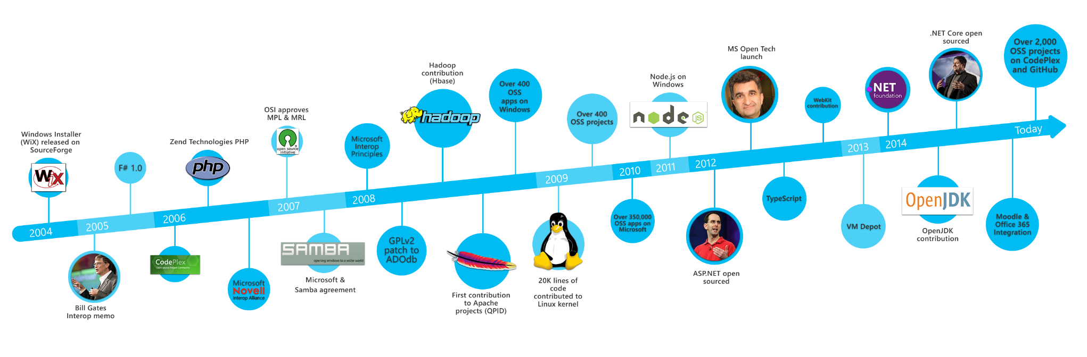
你知道吗？

Slide 5






















Azure Open Source Application Platform
Preview
GA
Stakeholders
Developers
Operations
DBAs and data scientists
Business
Office
PowerBI
Virtual Machines
VM Scale Sets
Container Service
Batch
Open Source PaaS
Service Fabric
App Service
Environments
Web, Mobile & API
Logic
Functions
Stateful and stateless one-off solutions
Scalable solutions
Scalable, orchestrated Docker images deployed into containers
Custom High Performance Computing solutions
Custom Microservice-based stateless and stateful solutions
All the goodness of App Service in a dedicated environment
Template based rapid development web, mobile and API solutions
Orchestrated workflow based integration solutions
Event driven on-demand compute
Cloud Foundry,
OpenShift
Build on the infrastructure
Build on the platform
New Serverless!
Lift-and-shift + net new on Linux
Docker
Cloud-born
LOB
Microsoft Azure

Slide 6
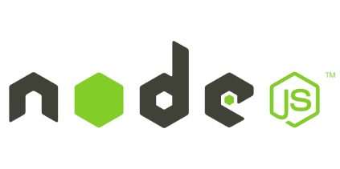

Node.js in Azure…
Azure is in 22 regions today, including China – 8 more announced
1 in 4 VMs in Azure run Linux – a great choice for Node.js!
And about 1 in 4 Web Apps run open source frameworks, like Node.js ☺
Thousands of Node.js sites run in Azure today! 我们学到了什么？

Slide 7




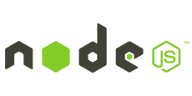
350,000 新用户
1,000 每一天!
20 部署以秒为单位
“Using Microsoft Azure Web Sites, we had no difficulty scaling quickly to support 350,000 new users, including 1,000 new users every day. We’re very confident that Azure will continue meeting our growth needs.”
JOHNNY HALIFE CHIEF ARCHITECT AND CO-FOUNDER MURAL.LY
Business need:
Mural.ly, an interactive whiteboard used by teams to collaborate in real time, needed a way to grow and scale efficiently without worrying about disrupting performance or managing underlying infrastructure.
Benefits:
Support 1,000 new users every day
Deploys 20x per day in a matter of seconds
More time to build new features
Higher scale and security to attract enterprise customers

Slide 8
Node.js in Azure: 分享我们学到了什么
JavaScript is everywhere
Node.js has great performance
Node.js has a great community
You can use Node.js for many things, like
Real-time communication (Socket.IO)
REST API with a single page application (SPA, Angular)
REST API with hybrid clients (Express, Node)
…and much more!

Slide 9


Slide 10
Cloud: 程序猿想要的东西
Make it easy to deploy
Packer, Bitnami
Make it easy to scale
Autoscale, VM Scale Sets, Containers
Decoupling state is important
Make it easy to do more
Managed databases, instrumentation, identity

Slide 11



MEAN Stack

Slide 12
Demo…

Slide 13
?
MEAN Stack

Slide 14
Node.js
Mongo

Slide 15

Mongo
Mongo
Node.js PaaS
Mongo

Slide 16

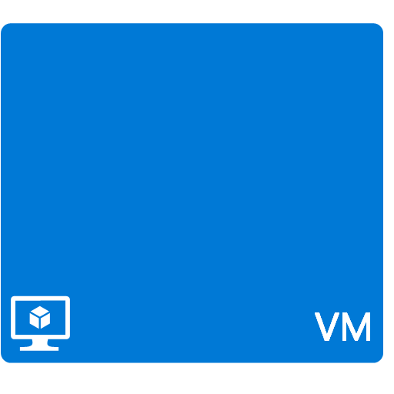





Node.js PaaS
Queues
Functions
DocumentDB
VM Scale Sets
Container Solutions

Slide 17
Back to demo…

Slide 18
Q+A

Slide 19
azure.com/opensource
opensource@microsoft.com
channel9.msdn.com/blogs/open

Slide 20













Storage
Many deployment options
from VMs to containers
Tools
Management
Application
Insights
IoT
End to end Node.js solution in the cloud
DocumentDB
Service Bus
Active Directory

Slide 21





























Microsoft Cloud Container Portfolio
Developer & Data Agility with Containers in the Cloud
Developers
Operations
Data scientists
OMS
Docker VM Extension for Azure
Open source container-based PaaS platforms in Azure
Azure Container Service
Azure Marketplace container partners
Easy and programmatic way to add Docker capabilities to your VMs
Container-ready application platforms that benefit from Azure’s native partitioning, capacity management and high availability
Optimized container hosting in the cloud with familiar tooling and your choice of orchestrator
Partner solutions that address management challenges of containers
Microsoft Azure
Workload portability
Cross-cloud orchestration
Tools integration
Windows Server (preview)
Azure Stack (roadmap)
Your own platform

Slide 22
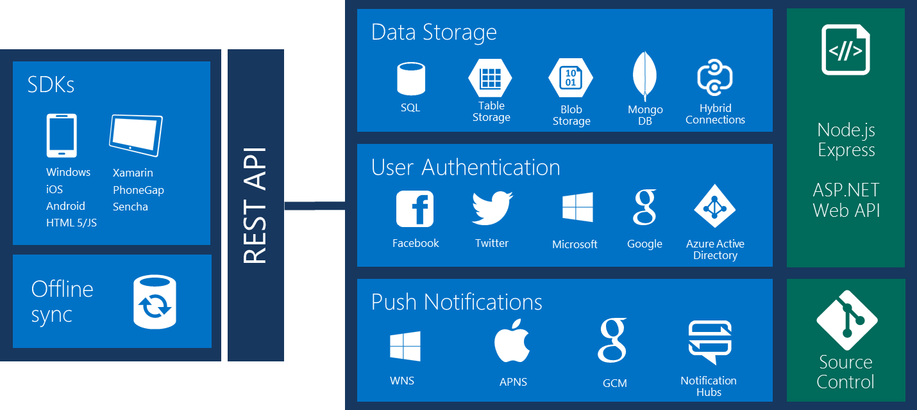
Azure Mobile Services

Slide 23
Application Insights: Key capabilities
Visibility, insights, and analytics
Sources of telemetry
Node.JS
Instrument your node site with Application Insights!
360⁰ view across availability, performance, and usage
Fast and powerful diagnostics and usage insights
Built-in analytics for any app
$ npm install applicationinsights
var appInsights = require("applicationinsights");
appInsights.setup("<instrumentation_key>").start();
Microsoft/ApplicationInsights-node.js
Notes:
1)Outside-in monitoring
URL pings and web tests from 16 global points of presence
2)Observed user behavior
How is the application being used?
3) Developer traces and events
Whatever the developer would like to send to Application Insights
4) Observed application behavior
No coding required – service dependencies, queries, response time, exceptions, logs, etc.
5) Infrastructure performance
System performance counters

Slide 24


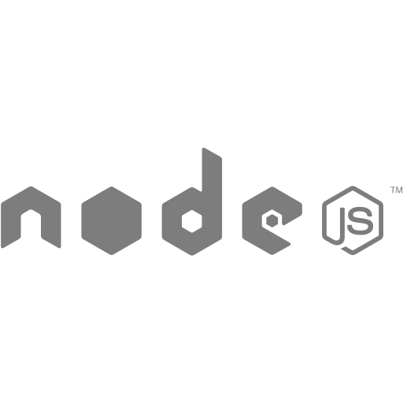
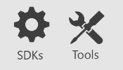
Tools and SDKs for DocumentDB
REST over HTTPS/TCP
Java
.NET
DocumentDB
Notes:
Have numbers to back up these points

Slide 25
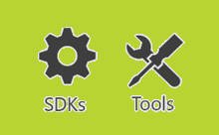

Introducing protocol support for MongoDB
Ruby
…
MongoDB wire protocol
Java
.NET
drivers for MongoDB
REST over HTTPS/TCP
Java
.NET
DocumentDB
Notes:
Have numbers to back up these points

